Slide 1
Radiation & Cancer Biology Course for Residents (Part 1) Boards Review Questions

Slide 2
Hallmarks of Cancer

Slide 3
Which hallmark of cancer helps create a supportive microenvironment for tumor cells?
A. Resisting cell death
B. Enabling replicative immortality
C. Inducing senescence
D. Chronic inflammation

Slide 4
Which statement concerning tumor suppressor genes is FALSE?
A. Loss of heterozygosity is a mechanism for the inactivation of tumor suppressor genes.
B. Tumor suppressor proteins generally accelerate cell growth.
C. Typically, one or more tumor suppressor genes are mutated or absent in human cancers.
D. The most commonly mutated tumor suppressor gene is TP53.
E. The first tumor suppressor gene identified was RB1.

Slide 5
Which does NOT routinely lead to oncogene activation?
A. gene amplification
B. chromosomal translocation
C. chromosomal deletion
D. overexpression of miRNAs
E. point mutation

Slide 6
True-False Questions:
Radiomics is the use of advanced computational analysis of medical images to extract quantitative data.
True
The microbiome can affect responses to radiation and chemotherapy.
True
The mechanism of action for oxygen-mimetic radiosensitizers is fixation of radiation-induced free radical damage to DNA.
True

Slide 7
True-False Questions (cont.):
Tumor cells that have lost RB activity become insensitive to growth suppression.
True
Inactivation of telomerase causes cellular immortalization.
False
The •OH radical can damage cellular macromolecules via hydroxyl abstraction.
False

Slide 8
True-False Questions (cont.):
Inactivation of telomerase causes cellular immortalization.
False
The •OH radical can damage cellular macromolecules via hydroxyl abstraction.
False

Slide 9
Radiation Chemistry & Free Radicals

Slide 10
The average annual dose equivalent to the US population from natural background radiation is approximately:
A. 30 µSv
B. 100 µSv
C. 300 µSv
D. 3 mSv
E. 10 mSv

Slide 11
What influences the initial yield of radiation-induced DNA strand breaks?
A. ATM phosphorylation
B. Histone methylation status
C. Oxygen tension
D. Abundance of RAD51

Slide 12
Less damage occurs per unit dose for x-irradiated DNA in a powdered state than in an aqueous solution because:
A. dry DNA tends to become more hypoxic than DNA dissolved in solution.
B. chromatin conformation is more open in a dry versus aqueous state, affecting the DNA's radiosensitivity.
C. DNA repair half-times are much longer for DNA in an aqueous solution than in the dry form.
D. free radicals liberated by the radiolysis of water account for most of the total radiation-induced DNA damage.

Slide 13
Which radiochemical processes best describes chemical restitution? (Assume that “T” represents some target molecule whose inactivation results in a biological effect.)
A. TH ---> T• + H•
B. TH + •OH ---> T• + H2O
C. T• + O2 ---> T-O-O•
D. T• + HS-CH2-CH2-NH2 ---> TH + S-CH2-CH2-NH2•

Slide 14
The largest source of natural background radiation exposure to the human population is:
A. cosmic rays
B. diagnostic imaging procedures
C. internalized radionuclides
D. radon
E. radioactivity in the rocks and soil

Slide 15
Which statement about radiation-induced locally multiply damaged sites (LMDS) in DNA is FALSE?
A. LMDS can consist of one or more closely spaced types of DNA damage
B. Most DNA damaging agents produce LMDS.
C. LMDS can be inherently more difficult to repair.
D. High LET radiation exposure causes an increase in both the number and complexity of LMDS per unit dose.

Slide 16
What is the proportion of indirect versus direct damage in cells irradiated with carbon ions?
A. 20% indirect, 80% direct
B. 40% indirect, 60% direct
C. 70% indirect, 30% direct
D. 100% indirect
E. 100% direct

Slide 17
The reason that high LET radiation is more effective in killing cells than low LET is that:
A. high LET radiation penetrates the cell better.
B. DNA damage from high LET radiation is more severe.
C. the nucleus of the cell is selectively damaged by high LET radiation.
D. high LET radiation does not need oxygen for its maximum effect.

Slide 18
True-False Questions:
Radical scavenging agents such as glutathione can reduce radiation-induced DNA damage, and therefore, cell killing.
True
Oxygen participates in free radical reactions by contributing to the restitution process.
False
The most significant source of man-made background radiation exposure to the public is the nuclear power industry.
False

Slide 19
DNA Damage Response

Slide 20
Colorectal cancer cells that are hypermutated have defects in:
A. mismatch repair.
B. nucleotide excision repair.
C. base excision repair.
D. homologous recombination.
E. non homologous end joining.

Slide 21
Which technique is typically used to detect and analyze ctDNA?
A. Mass spectrometry
B. Polymerase chain reaction (PCR)
C. Immunohistochemistry
D. Flow cytometry

Slide 22
Approximately how many DNA double strand breaks are produced by 1 Gy of X-rays?
A. 1 to 20
B. 21 to 40
C. 41 to 60
D. 61 to 89

Slide 23
Which syndrome is caused by a deficiency in the DNA repair-associated protein MRE11?
A. Werner’s syndrome
B. AT-like disorder
C. xeroderma pigmentosum
D. Bloom’s syndrome
E. Cockayne’s syndrome

Slide 24
Following a dose of 1 Gy of X-rays, which type of DNA damage is most abundant?
A. single strand breaks
B. double strand breaks
C. base damage
D. crosslinks

Slide 25
An inactivating mutation in one allele of which gene would most likely result in an increased risk of a radiation-induced cancer?
A. XPC
B. MLH1
C. PTEN
D. ATM
E. CHEK2

Slide 26
Which statement concerning the use of PARP inhibitors to produce synthetic lethality in BRCA mutant cells is TRUE? PARP inhibitors block the repair of:
A. SSBs, causing DSBs to form that can’t be repaired by cells lacking non-homologous end joining.
B. SSBs, causing DSBs to form that can’t be repaired by cells lacking homologous recombination.
C. DSBs, and these can’t be repaired in cells lacking non-homologous end joining.
D. DSBs, and these can’t be repaired in cells lacking homologous recombination.

Slide 27
Which tumor suppressor gene is mutated or lost in Li-Fraumeni syndrome?
A. RB
B. BRCA-1
C. NF1
D. APC
E. TP53

Slide 28
Homologous recombination repair of DNA double strand breaks is most likely to occur:
A. in G₀
B. in G₁
C. in early S phase
D. in G₂
E. throughout the cell cycle

Slide 29
Which statement about the DNA damage response is FALSE?
A. DNA-PKcs, ATM and ATR are serine-threonine kinases.
B. DNA-PKcs, ATM and ATR are tyrosine kinases.
C. ATM phosphorylates Chk2 and p53.
D. ATM phosphorylates substrates with the amino acid motif pS/T-Q
E. Histone H2AX is a substrate for ATM.

Slide 30
Which protein kinase does NOT phosphorylate histone H2AX at sites of DNA DSBs?
A. mTOR
B. ATM
C. DNA-PK
D. ATR

Slide 31
Normal tissue complications are most likely to be seen following conventional radiotherapy in patients suffering from:
A. ataxia telangiectasia
b. systemic lupus erythematosus
c. Bloom's syndrome
d. xeroderma pigmentosum
e. Fanconi's anemia

Slide 32
Which statement about PARP1 and its inhibition is TRUE? PARP1:
A. is a transcription factor.
B. is an pro-apoptotic protein.
C. is a protein kinase.
D. inhibition can produce synthetic lethality.
E. phosphorylates histone H2AX.

Slide 33
What is the most abundant type of DNA damage caused by low LET radiation?
A. single strand breaks
B. double strand breaks
C. base damage(s)
D. DNA-protein crosslinks
E. DNA-DNA crosslinks

Slide 34
Genetic & Epigenetic Effects

Slide 35
The approximate dose range thought to double the spontaneous incidence of a germ line mutation in humans is:
A. 20-50 mSv
B. 100-200 mSv
C. 400-500 mSv
D. 700-800 mSv
E. 1-2 Sv

Slide 36
Which statement about the heritable effects of radiation exposure is TRUE?
A. Heritable effects appear in the exposed individual.
B. Heritable effects can be divided into two classes: prompt and delayed.
C. Typically, there’s a lower risk of heritable effects than somatic effects.
D. Carcinogenesis is the least likely heritable effect.

Slide 37
Most radiation-induced gene mutations in human cells are:
A. deletions.
B. frameshifts.
C. transitions.
D. transversions.

Slide 38
What source is responsible for approximately two-thirds of driver mutations in human cancers?
A. Hereditary mutations
B. DNA replication errors
C. Smoking
D. Ionizing radiation
E. HPV infection

Slide 39
Which best describes the radiation dose response for dicentric chromosome aberrations in peripheral blood lymphocytes?
A. A linear-quadratic dose response following low LET irradiation at a low dose rate
B. A linear-quadratic dose response following low LET irradiation at a high dose rate
C. A quadratic dose response following low LET irradiation at a high dose rate
D. A linear-quadratic dose response following high LET irradiation at a high dose rate

Slide 40
Which statement concerning the “Mega Mouse” project assessing the heritable effects of radiation exposure is TRUE?
A. Genetic effects in subsequent generations were reduced the longer the time between irradiation and conception.
B. Mutation frequencies for different traits varied with age at the time of irradiation.
C. Male mice experienced temporary sterility for doses ≥6 Gy.
D. There was no dose rate effect for mutagenesis in mice.

Slide 41
_______ are among the types of chromosome aberrations most associated with radiation carcinogenesis.
A. Dicentrics
B. Acentric fragments
C. Translocations
D. Terminal deletions
E. Ring chromosomes

Slide 42
Epigenetic silencing of which gene increases the effectiveness of temozolomide in patients with glioblastoma?
A. PTEN
B. EGFR
C. MGMT
D. CDKN2A

Slide 43
Which statement about epigenetics is FALSE?
A. Epigenetic modification alters chromatin structure but not the DNA sequence.
B. Epigenetic modification alters both chromatin structure and the DNA sequence.
C. Histone methylation is an example of epigenetic modification.
D. Histone acetylation is an example of epigenetic modification.
E. DNA methylation is an example of epigenetic modification.

Slide 44
Which is NOT an example of an epigenetic modification?
A. Histone 3 lysine 27 trimethylation
B. V600E mutation in the BRAF gene
C. DNA CpG island hypermethylation
D. MGMT gene promoter methylation

Slide 45
Radiation-induced cell killing correlates best with the induction of which type of chromosome aberration?
A. terminal deletions
B. sister chromatid exchanges
C. reciprocal translocations
D. inversions
E. asymmetrical exchange-type aberrations

Slide 46
miRNAs:
A. bind to and inhibit the replication of target genes
B. stimulate ribosomal and transfer RNA synthesis.
C. average 100 kb in size.
D. enhance transcription factor binding to DNA.
E. post-transcriptionally regulate gene expression.

Slide 47
What is the lowest x-ray dose for which a signiﬁcant increase in the number of dicentric chromosome aberrations per cell can be detected?
A. 0.01 Gy (1 cGy)
B. 0.1 Gy (10 cGy)
C. 1 Gy (100 cGy)
D. 10 Gy (1,000 cGy)

Slide 48
Which type of chromatid aberration interferes with mitosis and causes prompt cell death?
A. acentric fragment
B. anaphase bridge
C. dicentric
D. terminal deletion

Slide 49
Which type of chromosome aberration can be detected 20 years after irradiation?
A. anaphase bridge
B. dicentric
C. micronuclei
D. reciprocal translocation
E. terminal deletion

Slide 50
Which statement concerning chromosome aberrations is TRUE?
A. The formation of terminal deletions follows an exponential dose response.
B. A translocation is an asymmetric type of chromosome aberration.
C. The number of dicentric chromosomes remains relatively constant over time.
D. Spectral karyotyping can detect stable chromosome aberrations decades after irradiation.
E. The minimum dose that can be reliably estimated by scoring dicentrics is approximately 2 Gy.

Slide 51
Mechanisms of Cell Death

Slide 52
From the perspective of a radiobiologist, "cell death" means:
a. cessation of metabolic activity.
b. loss of membrane integrity.
c. loss of clonogenicity.
d. cessation of cell cycle transit.

Slide 53
The initiation of necroptosis requires the kinase activity of:
A. ATM
B. DNA-PK
C. RIP1
D. CDK4

Slide 54
Persistent overexpression of which protein can induce cellular senescence?
A. PUMA
B. Bcl-2
C. p16
D. LC3

Slide 55
Ongoing clinical trials are testing MDM2 inhibitors, which may cause tumor regression by degrading MDM2 and thereby activating:
A. E2F
B. p53
C. p16
D. myc
E. ATM

Slide 56
Which statement is TRUE concerning the roles Bcl-2 family member proteins play in the apoptosis process?
A. Bax inhibits apoptosis while Bcl-2 promotes it.
B. Bax promotes apoptosis while Bcl-2 inhibits it.
C. Both the Bax and Bcl-2 proteins inhibit apoptosis.
D. Both the Bax and Bcl-2 proteins promote apoptosis.

Slide 57
Mitotic catastrophe is:
A. caused by defective cell cycle checkpoint control.
B. the predominant mechanism of cell death in irradiated lymphocytes.
C. a consequence of chromosome aberrations and/or mitotic spindle defects.
D. a form of irreversible growth arrest.

Slide 58
Large, single doses of X-rays (>12 Gy) upregulate which protein, resulting in the degradation of cytoplasmic double-stranded DNA?
A. cGAS
B. STING
C. PD-L1
D. TREX1
E. MHC-I

Slide 59
Which is a cellular feature of necrosis?
A. cytoplasmic shrinkage
B. chromatin condensation
C. cell swelling
D. nuclear swelling

Slide 60
Which statement concerning radiation-induced apoptosis is FALSE? Apoptosis:
A. plays a major role in the local control of most solid tumors.
B. can occur after relatively low radiation doses.
C. begins within a few hours of irradiation.
D. usually requires wild-type TP53

Slide 61
Which mode of cell death is triggered by lipid peroxidation?
A. ferroptosis
B. pyroptosis
C. autophagy
D. senescence

Slide 62
Which cell type is killed by p53-dependent apoptosis after irradiation in vivo?
A. cardiomyocytes
B. hematopoietic progenitor cells
C. vascular endothelial cells
D. ﬁbroblasts

Slide 63
Senescent cells:
A. die during or soon after an aberrant mitosis
B. die spontaneously a few hours after irradiation
C. permanently arrest in G1 phase of the cell cycle
D. are prone to neoplastic transformation

Slide 64
Which protein is a marker for senescent cells?
A. cleaved caspase 3
B. β-galactosidase
C. receptor-interacting serine/threonine-protein kinase 3 (RIP3)
D. sodium-independent cystine-glutamate antiporter

Slide 65
Which cell type is most likely to die by apoptosis following irradiation?
A. post-synaptic motor neurons
B. CD8+ lymphocytes
C. Type 1 pneumocytes
D. ﬁbroblasts
E. vascular endothelial cells

Slide 66
Radiation-induced free radical damage to cell membranes produces _____, a potent trigger of apoptosis.
A. beclin
B. cytochrome C
C. ceramide
D. calreticulin

Slide 67
What is the role of the SASP (Senescence-Associated Secretory Phenotype) in senescent cells?
A. Promotes accelerated cell proliferation
B. Induces inflammation that can affect neighboring cells
C. Enhances DNA repair
D. Inhibits telomerase activity

Slide 68
What is the primary purpose of senescence in multicellular organisms?
A. Promote cell proliferation
B. Hinder carcinogenesis
C. Enhance tissue regeneration
D. Increase metabolic activity

Slide 69
True-False Questions:
Cell death by autophagy requires progression through the cell cycle.
False
Cells that have undergone mitotic catastrophe often contain micronuclei.
True
Some cells containing radiation-induced chromosome aberrations die at the first mitosis following irradiation, but others may divide a few more times before dying.
True

Slide 70
Cell Survival & Tissue Dose Response Curves

Slide 71
Which statement best describes why the single hit, multitarget survival curve model was rejected in favor of the linear quadratic model?
A. The single-hit, multitarget model did not provide a good fit to cell survival data for high radiation doses.
B. The single-hit, multitarget model did not provide a good fit to cell survival data for low radiation doses.
C. The linear-quadratic model is based on Poisson statistics, but the single-hit, multitarget model wasn’t.
D. The linear-quadratic model is more robust in terms of correcting for effects of repopulation and cell cycle redistribution.

Slide 72
The spleen colony assay of Till and McCulloch demonstrated:
A. a non-clonogenic method of generating in vivo cell survival curves.
B. that in vivo and in vitro survival curves for mouse bone marrow were almost identical.
C. that only a few tumor cells need to be injected in a
mouse for a tumor to grow.
D. the radiation dose-response relationship for a mouse tumor.
E. that lethally irradiated mice could be saved by a spleen transplant.

Slide 73
The β component of the linear-quadratic model:
A. is a measure of irreparable DNA damage.
B. approximates 1.0 for low LET radiation.
C. increases with increasing LET of the radiation.
D. decreases with increasing fractionation or protraction.
E. has units of Gy⁻¹.

Slide 74
The skin reaction assay can be used to generate an in vivo dose response curve by:
A. removing skin cells from an irradiated animal and transferring them to an unirradiated animal to assess colony formation
B. removing skin cells from an irradiated animal and transferring them to Petri dishes for colony formation
C. measuring the severity of skin reactions using an ordinate scoring system as a surrogate for cell survival
D. monitoring the regrowth of nodules in irradiated areas of the animal’s skin

Slide 75
If a cell line’s D₀ is equal to its D₃₇, then n equals:
A. 0.37
B. 0.63
C. 1.0
D. 3.7
D₀ = dose to reduce cell surviving fraction to 37% of its initial value on the exponential portion of the survival curve (i.e. NOT in the shoulder region)
D₃₇ = dose to reduce cell surviving fraction from 100% → 37%, regardless of the shoulder region
When D₃₇ = D₀, this must mean there’s no shoulder on the survival curve, so n = 1.0

Slide 76
A particular cell line is characterized by a radiation survival curve with a D₀ of 1.5 Gy and an n of 4.0. A mutated version of the same type of cell has a survival curve with a D₀ of 1.5 Gy and an n of 10.0. Which statement best describes the relationship between the two cell survival curves?
A. The mutated cell has a shallower final slope to its survival curve.
B. The normal cell has a shallower final slope to its survival curve.
C. The normal cell has a steeper shoulder to its survival curve.
D. The mutated cell has a steeper shoulder to its survival curve.

Slide 77
How does reducing the dose rate of low LET radiation affect the survival curve parameters α and β?
A. α is increased and β is reduced.
B. α is reduced and β is increased.
C. α is reduced and β is unchanged.
D. α is unchanged and β is reduced.

Slide 78
The regrowth delay assay is a:
A. clonogenic assay for irradiated normal tissues.
B. clonogenic assay for irradiated tumors.
C. non-clonogenic assay for irradiated normal tissues.
D. non-clonogenic assay for irradiated tumors.

Slide 79
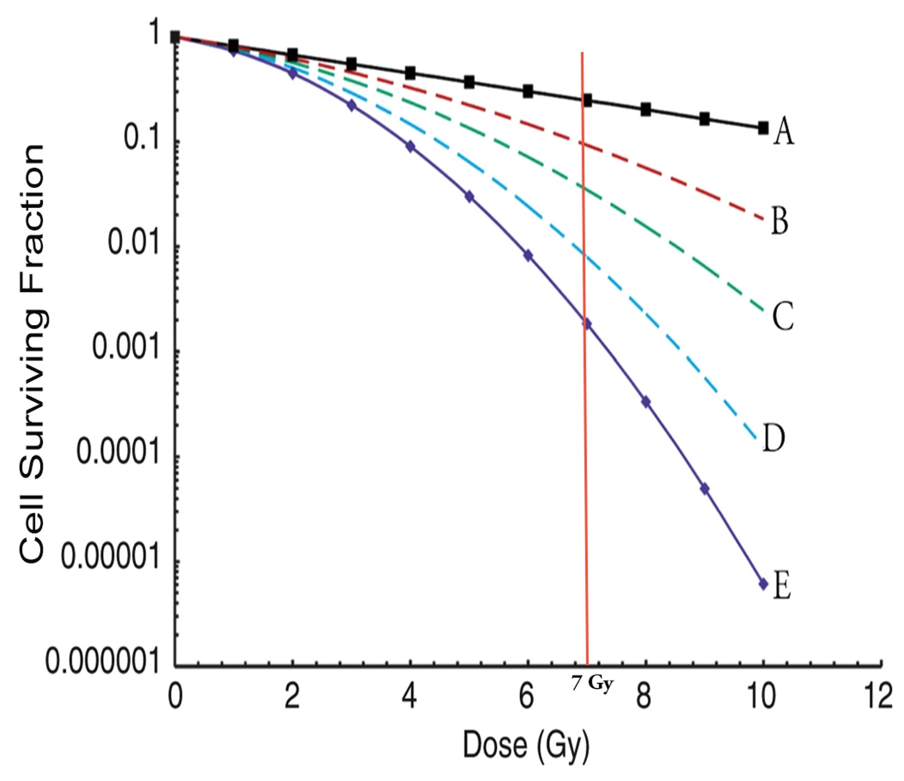
Which curve has the largest D₀?
A
Which curve has the largest “n”?
E
Which curve has n≈1.0?
A
Which curve is closest to being exponential?
A

Slide 80
Which is the correct sequencing of organisms from the most radiosensitive to the most radioresistant?
A. mammalian cells < viruses < yeast < E. coli
B. yeast < mammalian cells < viruses < E. coli
C. mammalian cells < yeast < E. coli < viruses
D. E. coli < viruses < mammalian cells < yeast

Slide 81
True-False Questions:
The survival curve parameters D₀, D_{q} and n are part of the linear-quadratic model of cell killing by ionizing radiation.
False
A patient who achieves a complete response during the course of radiation therapy can be considered cured.
False
Multifraction survival curves have smaller D₀’s than their corresponding single dose survival curves.
False

Slide 82
If the surviving fraction after a single dose of 2.0 Gy is 0.52, what is the surviving fraction for a tumor receiving once daily 2.0 Gy fractions to a total dose of 66 Gy?
A. 2.7 x 10⁻¹
B. 5.2 x 10⁻⁶
C. 4.2 x 10⁻¹⁰
D. 1.8 x10⁻¹⁹
Total dose of 66 Gy in 2 Gy fractions → 33 fractions
(0.52)³³ ≈ 4.2 x 10⁻¹⁰

Slide 83
If 1,000 cells are seeded into a petri dish, irradiated with 4 Gy, and 25 colonies form, what is the approximate percent survival assuming the cell line has a plating efficiency of 40%?
A. 6%
B. 16%
C. 26%
D. 36%
E. 46%
25 colonies out of 1,000 cells = 0.025 absolute surviving fraction
Plating efficiency = 0.4
Normalized surviving fraction = 0.025 ÷ 0.4 ≈ 0.06

Slide 84
What is the approximate total dose, delivered as multiple small fractions, required to produce a 99% probability of local control for a tumor containing 10¹⁰ clonogenic cells and with an effective D₀ of 2 Gy?
A. 35 Gy
B. 45 Gy
C. 55 Gy
D. 65 Gy
E. 75 Gy
TCD₉₉ → Average of 0.01 surviving cell per tumor
Tumor has 10¹⁰ cells, so to achieve a TCD₉₉, must reduce cell survival by 12 logs
For one log of cell killing → D₀ x 2.3 = 2 Gy x 2.3 = 4.6 Gy
4.6 Gy/log x 12 logs ≈ 55 Gy

Slide 85
Approximately how many cells will survive in a tumor containing 10⁹ clonogens after a fractionated treatment to a total dose of 40 Gy, assuming the effective D₁₀ is 5 Gy?
A. 10⁰
B. 10¹
C. 10²
D. 10⁵
E. 10⁸
10⁹ clonogenic tumor cells
D₁₀ = 5 Gy → meaning one log of cell killing per every 5 Gy
Total dose = 40 Gy, so with 5 Gy per one log of killing → means 8 logs of cell killing after 40 Gy
So, 10⁹ cells decremented by 8 logs = 10¹ survivors

Slide 86
A total dose of 12 Gy of X-rays delivered in 3 Gy fractions reduces cell survival to 10⁻⁴. Assuming that cell killing can be modeled using the equation S = e^{-αD}, what total dose would be required to reduce the surviving fraction to 10⁻⁶?
A. 9 Gy
B. 18 Gy
C. 24 Gy
D. 36 Gy
E. 72 Gy
12 Gy in 3 Gy fractions → 4 fractions in total
After 12 Gy, the surviving fraction is 10⁻⁴, meaning that each fraction reduced cell survival by one log
So, in order to get 2 additional logs of cell killing (10⁻⁶), would need another 2 fractions = 6 Gy more = 18 Gy

Slide 87
Sublethal/Potentially Lethal Damage Recovery & Fractionation

Slide 88
What accounts for the higher surviving fraction when delaying the subculture of cell after a large, single dose of X-rays, compared to cells cultured immediately after irradiation?
A. Repopulation
B. Cell cycle age response
C. Presence of hypoxia
D. Potentially lethal damage recovery
E. Sublethal damage recovery

Slide 89
Why would more late toxicity in normal tissues occur when dose fractions are delivered at 2 hour intervals versus 24 hour intervals?
A. more potentially lethal damage recovery
B. cell cycle redistribution
C. accelerated repopulation
D. incomplete sublethal damage recovery

Slide 90
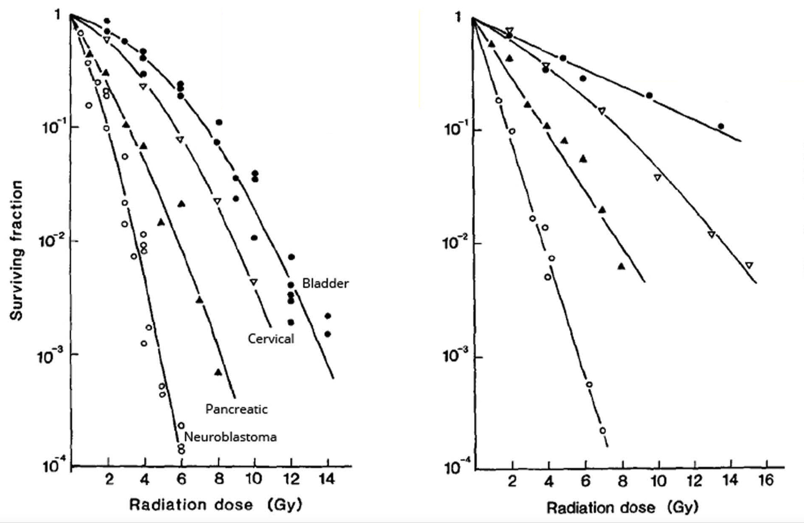
Single dose x-ray survival curves for four different human tumor cell lines are shown in the left panel of the below figure. Survival curves for the same cells under different irradiation conditions are shown in the right panel. Compared to the left panel, cells in the right panel:
A. became hypoxic during irradiation.
B. lack the nucleotide excision repair pathway.
C. were irradiated over an extended period.
D. were irradiated with neutrons instead of X-rays.

Slide 91
On a semi-log survival curve plot, what does an exponential dose response relationship indicate about a cell line?
A. a large βD² component of cell killing
B. cells were irradiated under hypoxic conditions
C. cells were irradiated with low LET radiation
D. no capacity for sublethal damage recovery

Slide 92
What effect would decreasing the time between two dose fractions from 4 hours to 30 minutes have on clonogenic cell survival?
A. increase
B. decrease
C. no change

Slide 93
For fractionated radiotherapy, each successive dose to the tumor results in the death of:
A. progressively fewer cells
B. progressively more cells
C. approximately the same number of cells
D. a variable number of cells
E. only S phase cells

Slide 94
Which statement is TRUE concerning sublethal and potentially lethal damage recovery?
A. The biological effectiveness of a given dose of (low LET) radiation decreases with decreasing dose rate.
B. PLDR is best demonstrated with a split dose experiment.
C. The magnitude of SLDR and PLDR is greater following exposure to high LET than low LET radiation.
D. PLDR is an important contributor to tumor radioresistance.

Slide 95
Which normal tissue would be expected to show the least amount of sparing when irradiated with X-rays at a low versus high dose rate?
A. breast
B. bone marrow
C. kidney
D. lung
E. spinal cord

Slide 96
As long as a minimum of _______ hours between successive dose fractions is allowed, sublethal damage should be fully repaired in normal tissues, causing the shoulder to return on the radiation survival curve.
A. 2
B. 4
C. 6
D. 12
E. 24

Slide 97
Regarding cell survival, sublethal damage recovery is:
A. similar for high vs. low LET radiation
B. enhanced by incubation of cells on ice
C. described by the β component of the LQ model
D. complete within 10 minutes after irradiation

Slide 98
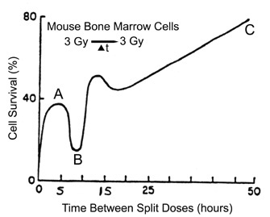
Describe the radiobiological phenomena that account for the shape of the split-dose recovery curve at positions A, B and C.
A =
Repair of sublethal damage
B =
Redistribution
C =
Repopulation

Slide 99
Cell Cycle Effects

Slide 100
Which is NOT a likely contributor to the cell cycle "age response"? As a function of cell cycle phase:
A. DNA damage repair mechanisms vary.
B. radical scavengers like glutathione vary in concentration.
C. the DNA conformation changes.
D. cell cycle checkpoint control varies in stringency.

Slide 101
Cells lacking activity of which cell cycle-related protein would be LEAST likely to show an inverse dose rate eﬀect?
A. CDK2
B. Cyclin B
C. Cyclin E
D. p53
E. WEE-1

Slide 102
Mammalian cells are most sensitive to ionizing radiation in the ____ phase of the cell cycle.
A. G1
B. S
C. G2
D. M
E. G0

Slide 103
Which protein is upregulated in a p53-dependent manner in response to DNA damage?
A. ATM
B. ATR
C. p16
D. p21
E. p63

Slide 104
What is the function of the tumor suppressor protein p21? p21:
A. targets ATM for destruction.
B. promotes tumor angiogenesis.
C. inhibits cyclin dependent kinases.
D. activates the MAPK pathway.

Slide 105
True-False Questions:
The CDKN2A gene – that codes for the p16 cell cycle-related protein – is a transcriptional target of p53.
False
The Cyclin D – CDK4/6 complex is active during G2 phase of the cell cycle.
False
Tumor cells that have lost RB activity become insensitive to growth suppression.
True

Slide 106
LET, RBE & High LET Radiotherapy

Slide 107
Which statement comparing carbon ion with proton beam radiotherapy is FALSE?
A. Carbon ions are even better suited than protons for the type of precision radiotherapy needed to treat tumors located near critical structures.
B. One advantage common to both carbon ion and proton radiotherapy is a reduced OER.
C. Both beams exhibit a Bragg peak.
D. The RBE for carbon ions is greater than for protons.

Slide 108
Particle selection for high LET radiotherapy should be determined by the particle’s ability to:
A. cause tumor cell senescence.
B. inhibit DNA repair in tumor cells.
C. maximize the number of ionizations per cell.
D. achieve the highest RBE and lowest OER.
E. selectively damage tumor vasculature.

Slide 109
Which type of radiation would produce a cell survival curve with the broadest shoulder?
A. 250 kVp X-rays
B. 5 MeV electrons
C. 1 MeV neutrons
D. 2 MeV α-particles
E. 275 MeV/nucleon carbon ions

Slide 110
What is the principal justification for the use of proton radiotherapy?
A. to produce irreparable DNA damage
B. to radiosensitize hypoxic tumor cells
C. to reduce the dose to normal tissues
D. to eliminate the age response through the cell cycle

Slide 111
For very high LET types of radiation:
A. toxicity is enhanced by using radiosensitizers.
B. tumor oxygenation remains unchanged after irradiation.
C. ●OH radicals do most of the DNA damage.
D. toxicity does not depend on the tissue’s oxygenation status.

Slide 112
Boron neutron capture therapy causes cell killing through the production of high LET:
A. protons
B. neutrons
C. carbon ions
D. α-particles and lithium ions

Slide 113
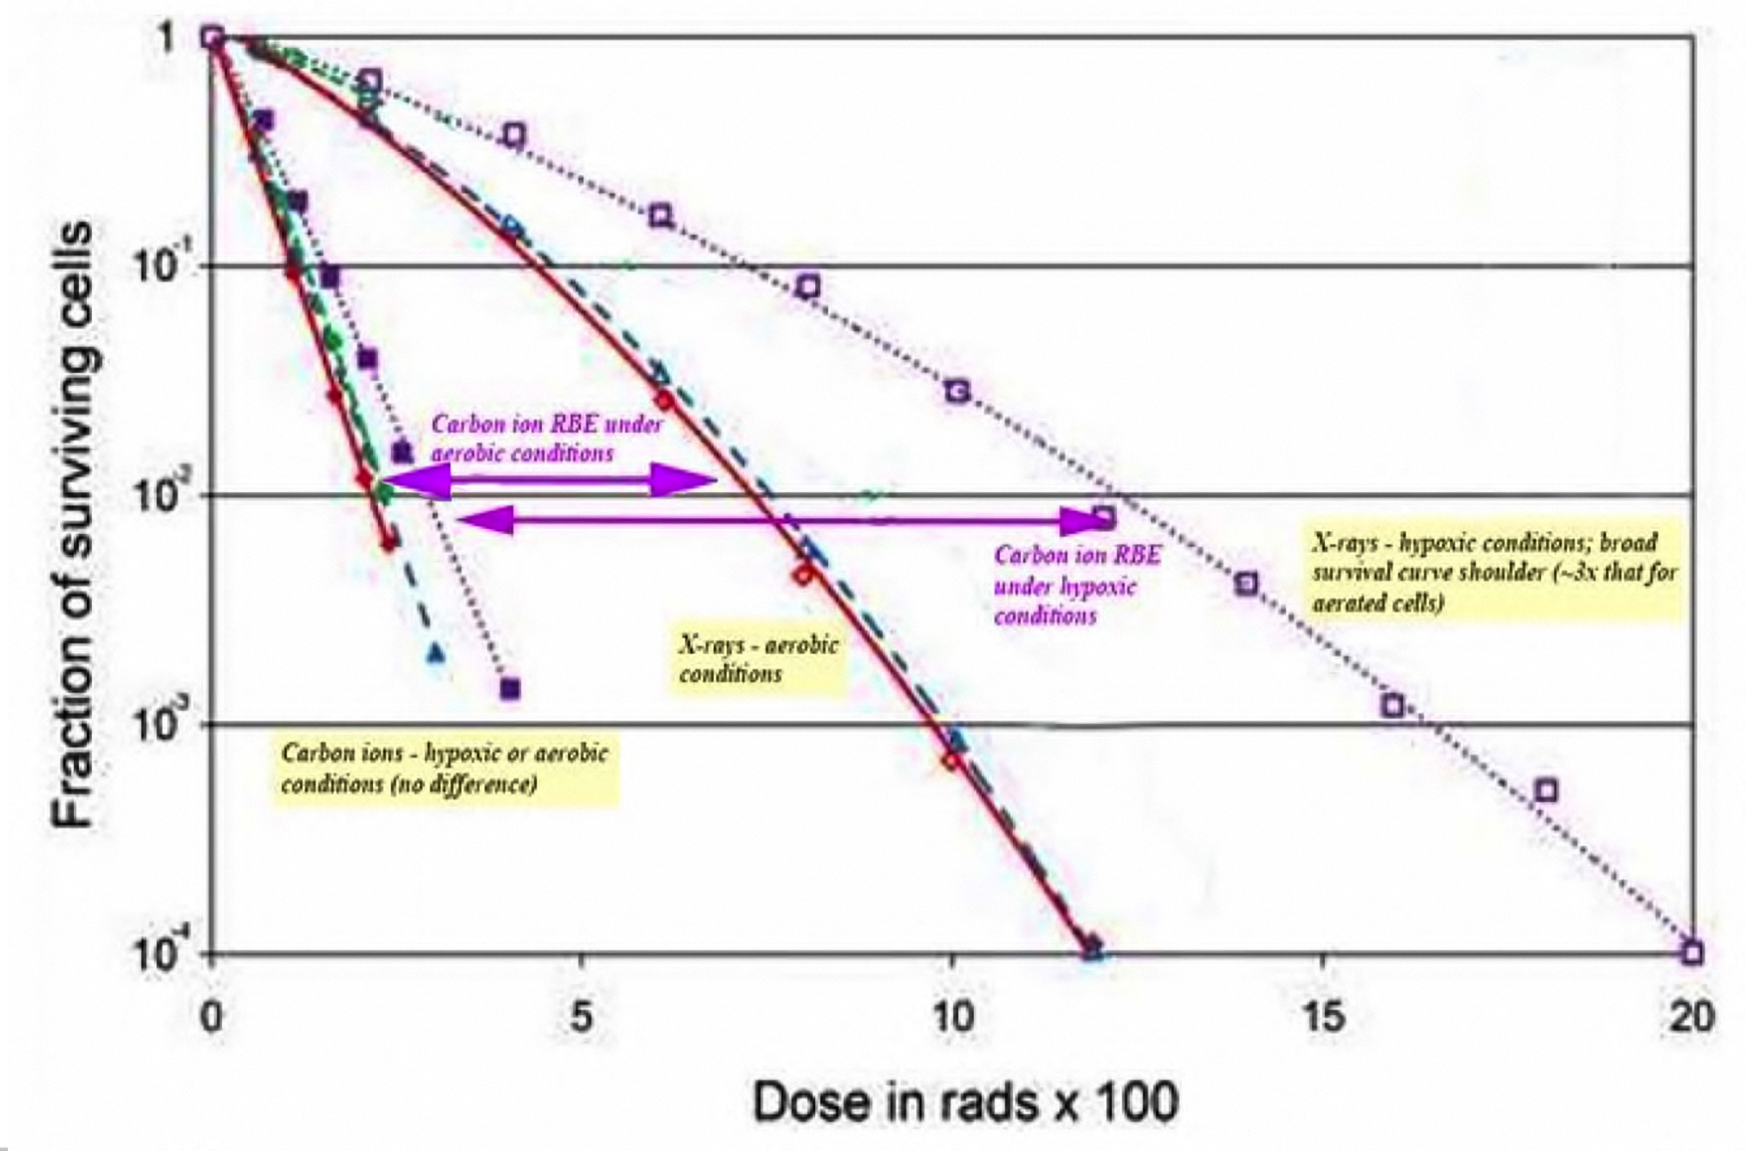
The carbon ion RBE for hypoxic cells compared to aerobic cells is:
A. equal
B. lower
C. higher
D. endpoint dependent

Slide 114
True-False Questions:
Ionizing radiations of extremely high LET (e.g., 2,000 keV/µm) are less biologically efficient than moderately high LET radiations.
True
One Gy of α-particles corresponds to an equivalent dose of 10 Sv.
False
For radiation protection purposes, we assume that embryos and fetuses are about 1.5 – 2.0 times more sensitive to radiation carcinogenesis than adults.
True

Slide 115
Radiation Carcinogenesis

Slide 116
If 25 radiation workers were involved in a nuclear power plant accident that exposed them acutely to 1.0 Sv, about how many excess, fatal cancers would be expected to develop over the workers' lifetimes?
A. none
B. about 2
C. about 5
D. about 10
E. about 20
● Acute dose of 1 Sv
● Radiation workers
Risk factor for excess fatal cancers in
radiation workers = 0.08 / Sv

Slide 117
What is the annual effective dose limit for radiation workers?
A. 0.01 Sv
B. 0.05 Sv
C. 0.5 Sv
D. 5 Sv
E. 50 Sv

Slide 118
The term stochastic is used to describe an effect of radiation in which the:
A. severity of the effect increases with increasing dose above a dose threshold.
B. severity of the effect increases with increasing dose without a threshold.
C. probability of the effect increases with increasing dose above a threshold.
D. probability of the effect increases with increasing dose without a threshold.
E. probability of the effect increases with increasing age at exposure.

Slide 119
Which second cancer is most likely to have been induced by prior radiation therapy?
A. ovarian cancer 11 years after breast-conserving therapy
B. angiosarcoma of the breast 12 years after breast-conserving therapy
C. leukemia 2 years after chemoradiotherapy for lymphoma
D. NSCLC in a smoker treated for SCLC 4 years earlier

Slide 120
Which radiation-induced effect in members of the public exposed to fallout from the Chernobyl accident was significantly elevated?
A. leukemia
B. thyroid cancer
C. non-specific life shortening
D. congenital abnormalities (in offspring)
E. cataracts

Slide 121
The main difference between effective dose and equivalent dose is:
A. whether the radiation exposure was internal or external.
B. the application of a radiation weighting factor.
C. the application of a tissue weighting factor.
D. that the former is measured in Sv and the latter in Gy.
E. that the former is applied to populations and the latter to individuals.

Slide 122
Which radiation-induced malignancy has the shortest latency period?
A. breast cancer
B. leukemia
C. lung cancer
D. prostate cancer
E. soft tissue sarcoma

Slide 123
Based on animal studies, which type of ionizing radiation is the LEAST potent carcinogen?
A. low LET X-rays (at a low dose rate)
B. low LET X-rays (at a high dose rate)
C. high LET neutrons
D. high LET heavy ions

Slide 124
All are possible mechanisms by which ionizing radiation initiates or promotes carcinogenesis, EXCEPT:
A. contributing to genomic instability
B. promoting cell death
C. increasing inflammation
D. generating reactive oxygen species

Slide 125
As a radiation oncologist who employs radiation-generating equipment and radioactive sources occupationally, which two radiation safety enforcement agencies are you most answerable to?
A. BEIR and NCRP
B. DHS and OSHA
C. DOE and EPA
D. DOT and EPA
E. FDA and NRC

Slide 126
According to the Life Span Study of Japanese a-bomb survivors, what best describes the dose response and time dependence for radiation-induced leukemia?
A. Linear dose response, with excess risk increasing over time
B. Linear dose response with excess risk decreasing over time
C. Linear-quadratic dose response, with excess risk increasing over time
D. Linear-quadratic dose response, with excess risk decreasing over time

Slide 127
What is the radiation weighting factor (W_{R}) used to calculate equivalent dose of protons?
A. 1
B. 2
C. 20
D. 50

Slide 128
Exposure to diagnostic X-rays in utero increases the relative risk of leukemia by a factor of approximately:
A. 1.0
B. 1.5
C. 3.5
D. 5.0

Slide 129
About how many CT scans are projected to cause one excess case of leukemia per year starting ~10 years after the scans?
A. 100
B. 1,000
C. 10,000
D. 100,000

Slide 130
Oxygen Effect & Tumor Hypoxia

Slide 131
In respiring tissue, the maximum diffusion distance of oxygen before tumor cells begin to become hypoxic is approximately:
A. 10 µm.
B. 70 µm.
C. 150 µm.
D. 300 µm.
E. 1.0 mm.

Slide 132
At a partial pressure of O₂ of 25 mm Hg, the D₀ for a population of cells is 1.5 Gy. If the partial pressure of O₂ increased to 250 mm Hg, the new D₀ would be approximately:
A. 0.5 Gy
B. 0.75 Gy
C. 1.5 Gy
D. 3.0 Gy
E. 4.5 Gy

Slide 133
Which statement concerning tumor hypoxia is FALSE?
A. Hypoxia induces apoptosis in cells with wild-type TP53.
B. Hypoxia markers can only detect hypoxic cells more than 200 µm from a blood vessel.
C. Hypoxia selects for tumor cells bearing mutant p53.
D. The OER for low LET radiation is greater than for high LET radiation.
E. Tumors containing clonogenic hypoxic cells have biphasic, acute dose x-ray survival curves.

Slide 134
Which statement regarding radiation and tumor hypoxia is TRUE?
A. Irradiation under hypoxic conditions yields more DNA strand breaks than under aerated conditions.
B. At a partial pressure of O₂ of 100 mm Hg, a tumor would be considered “clinically hypoxic”.
C. Oxygen need only be present during or within about a millisecond following irradiation to act as a radiosensitizer.
D. The OER for protons is higher than for X-rays.

Slide 135
The HIF-1 transcription factor is stabilized under hypoxic conditions because of:
A. increased activity of VHL.
B. increased transcription of HIF-1α.
C. reduced stability of HIF-1β.
D. reduced hydroxylation of HIF-1α.

Slide 136
Approximately what percent O₂ yields radiation sensitivity halfway between the fully aerobic and fully hypoxic responses?
A. 0.5%
B. 2%
C. 5%
D. 20%

Slide 137
All of the following processes are regulated by HIF-1, EXCEPT:
A. angiogenesis.
B. EPO production.
C. glycolysis.
D. p53 activation.
E. pH regulation.

Slide 138
Which protein causes the rapid degradation of HIF-1α under well-oxygenated conditions?
A. phosphoinositide 3-kinase (PI3K)
B. Von-Hippel Lindau (VHL)
C. hypoxia inducible factor β (HIF-1β)
D. carbonic acid anhydrase (CA-9)

Slide 139
Which is NOT a contributor to intermittent tumor hypoxia?
A. high interstitial fluid pressure
B. vascular stasis
C. aberrant blood vessel geometry
D. low oxygen consumption
E. shunting of blood flow

Slide 140
Which PET imaging agent can be used to detect hypoxic regions in human tumors?
A. ¹⁸F FHBG
B. ¹⁸F FDG
C. ¹⁸F FAZA
D. ²⁸Mg ATSM

Slide 141
On average, the radiobiological hypoxic fraction in rodent tumors is:
A. 0.15%.
B. 1.5%.
C. 15%.
D. 45%.
E. 60%.

Slide 142
HIF-1 signaling metabolically reprograms cancer cells by:
A. up-regulating glucose transporters.
B. increasing oxidative phosphorylation.
C. increasing conversion of pyruvate to acetyl-Co A.
D. decreasing glycolysis.

Slide 143
True-False Questions:
Patients with cervix tumors having low median values of pO₂ show reduced 5-year survival following radiotherapy alone.
True
Patients with tumors having low median values of pO₂ show reduced 5-year survival following surgery alone.
True
Hypoxia is a selective pressure for more aggressive tumor cell phenotypes.
True

Slide 144
True-False Questions:
HIF-1α is constitutively active and bound to the promoters of hypoxia responsive genes.
False
Lysyl oxidase (LOX) is an endogenous hypoxia marker.
True
The OER increases with increasing LET of the type of radiation.
False

